Slide 1


Ain Shams University
Faculty of Computer and Information Sciences Information Systems Department
DataForge
Automated Data Warehouse Schema Generator with AI-Driven Enhancements

Slide 2
Team members
Abdelrahman Abdelnasser Gamal Mohamed
Abdelrahman Adel Atta Mohamed
Ahmed Reda Mohamed
Ahmed Mahmoud Mohamed
Arwa Amr Elsharawy
Alaa Emad Abd ElSalam ElSayed
Under Supervision of
Dr. Yasmine Afify
TA. Yasmine Shaaban

Slide 3
Table of Contents
Introduction
Objective
System Architecture
Functions
Algorithms And Techniques
Demo

Slide 4
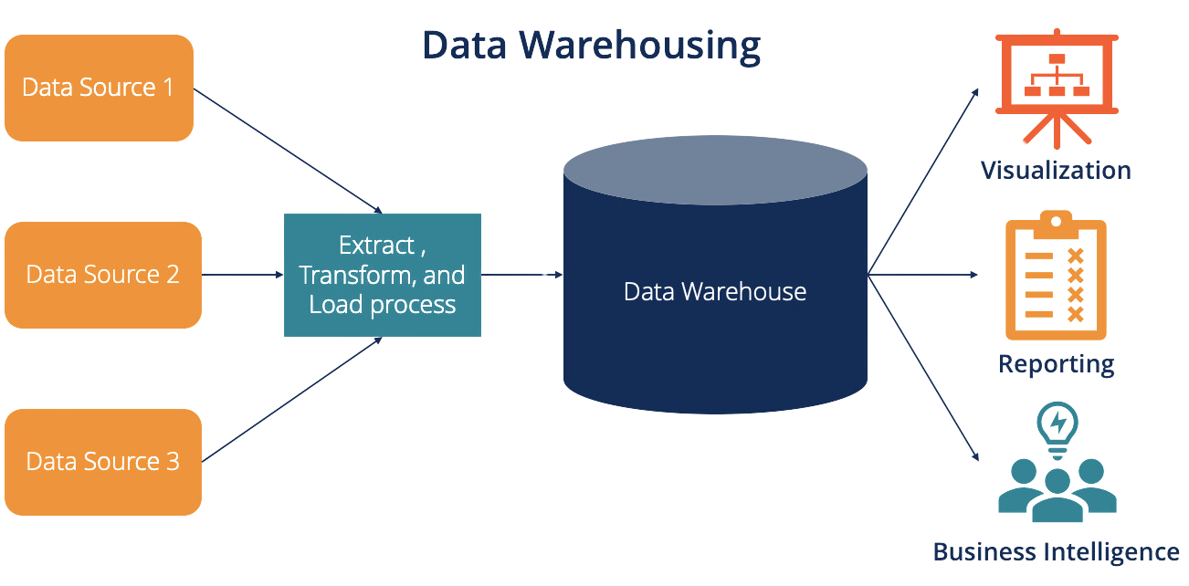
Introduction
A data warehouse is a centralized repository that stores large volumes of data from multiple sources, enabling efficient analysis and reporting.
Key Features:
Integration.
Historical Data Storage.
Optimized for Querying.
1
Notes:
Integration: Combines data from various operational systems (e.g., sales, marketing, finance) into a unified format.
Historical Data Storage: Maintains historical records, allowing for trend analysis over time.
Optimized for Querying: Designed to handle complex queries and large-scale data analysis quickly.

Slide 5
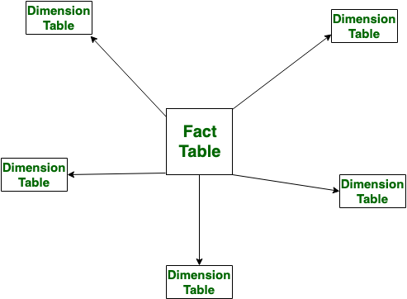
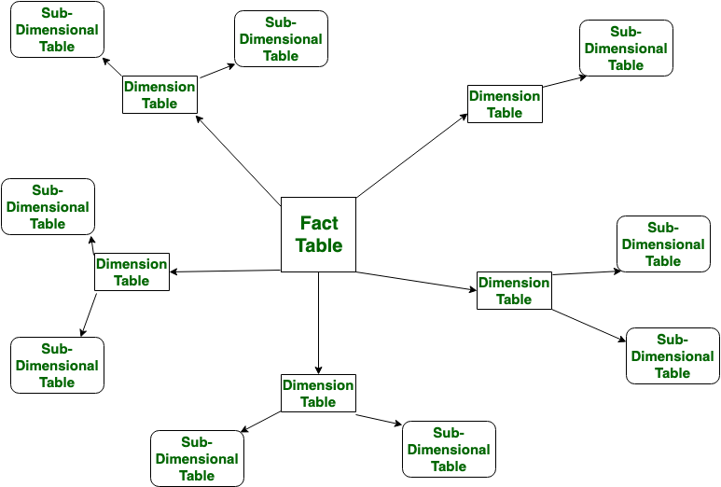
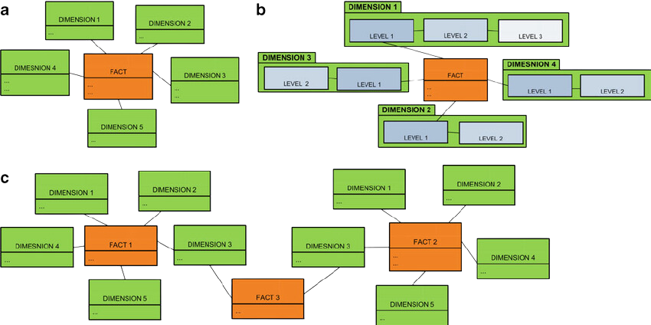
Data Warehouse Schema Types
SnowFlake Schema
Galaxy Schema
Star Schema
2

Slide 6
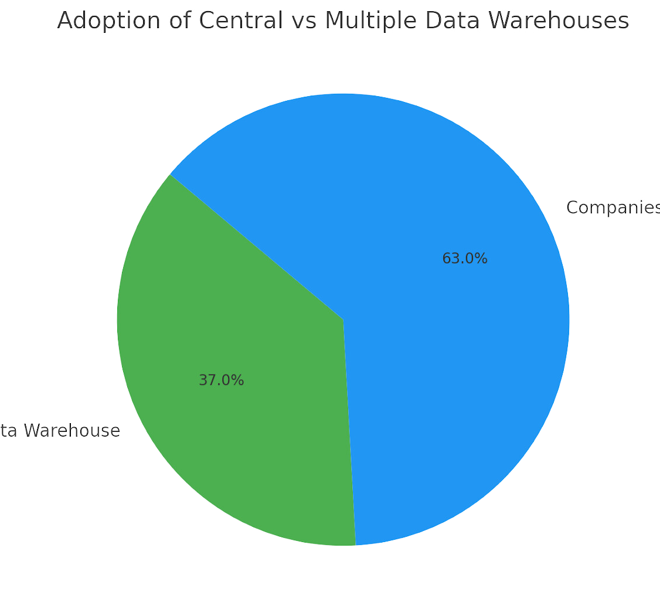
Introduction
Data-Driven Decision Making:
In today’s business landscape, data warehouses are essential for consolidating and analyzing vast amounts of information from diverse sources.
Current Adoption Rates:
37% of companies have a central data warehouse.
A significant 63% of organizations utilize multiple data warehouses.
https://www.existbi.com/blog/key-statistics-data-warehouse/
3

Slide 7
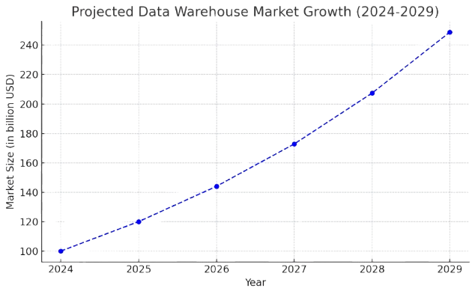
Introduction
Duration:
Data warehouse implementation typically takes 6-9 months.
Cost: Initial implementation costs start at around $70,000, with larger projects ranging up to $485,000.
Market Growth:
The data warehouse market is projected to grow by 20% annually over the next five years.
https://data-vault.com/data-warehouse-market-size/
4

Slide 8
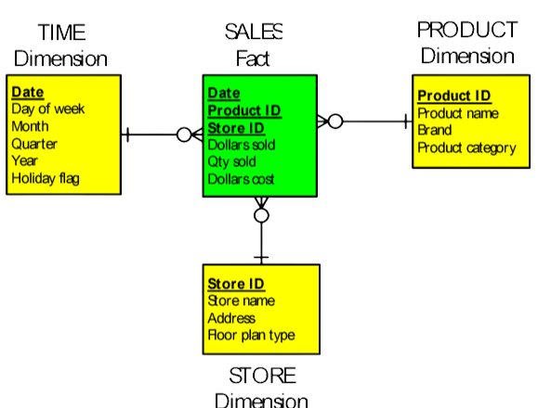
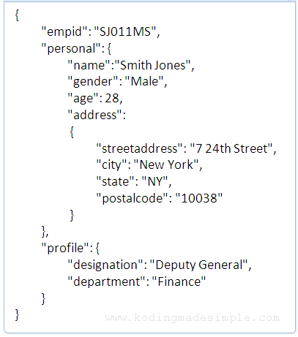

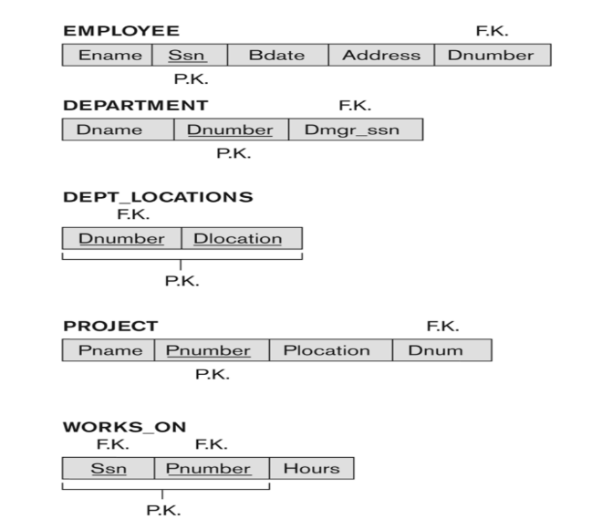
Objective
The objective of the DataForge project is to develop an automated tool that streamlines the creation of data warehouse schemas.
5

Slide 9
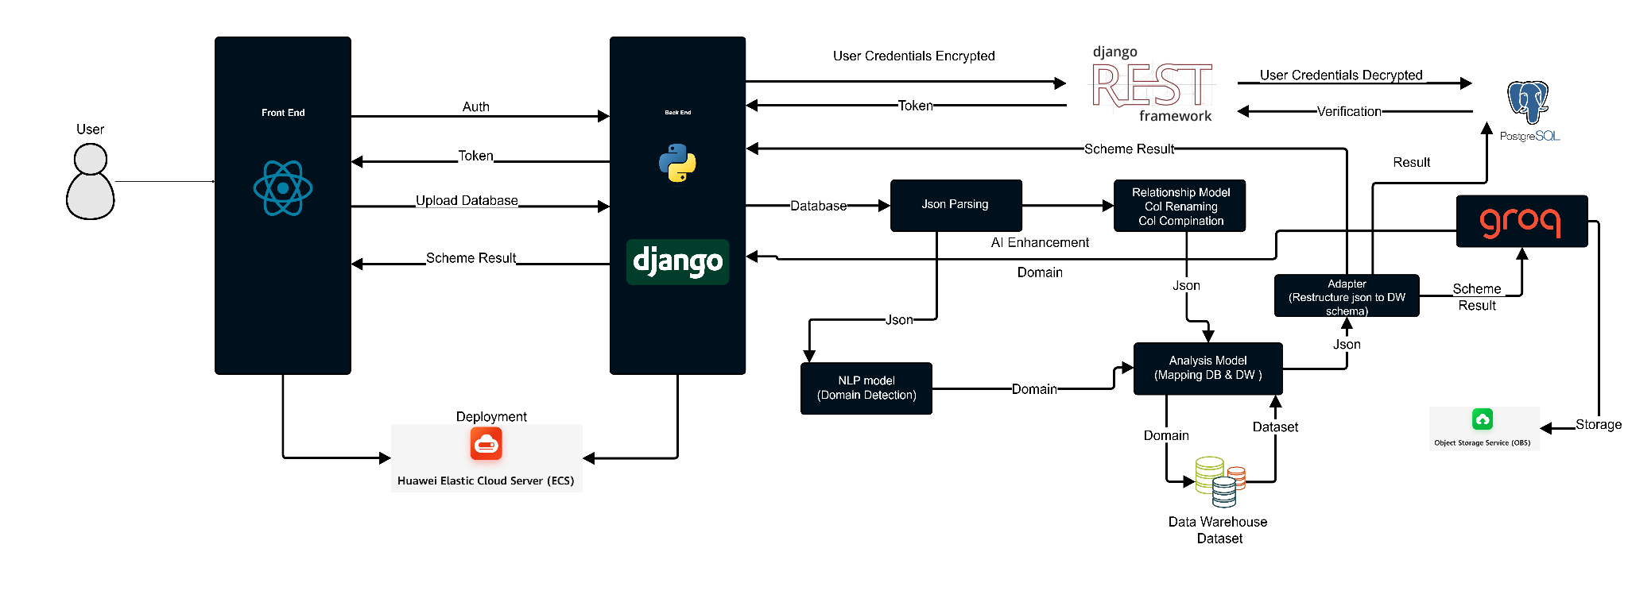
System Architecture
Schema Result
Schema Result
Schema
Result
6

Slide 10
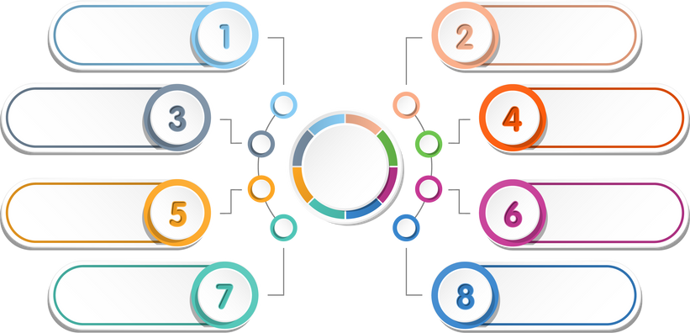
Implemented Functions
User Authentication
Domain Detection
Relationship Identification
Parsing to JSON
Data
Forge
Column Renaming
Column
Combination
Data Warehouse Mapping
AI-Driven Enhancement
7

Slide 11
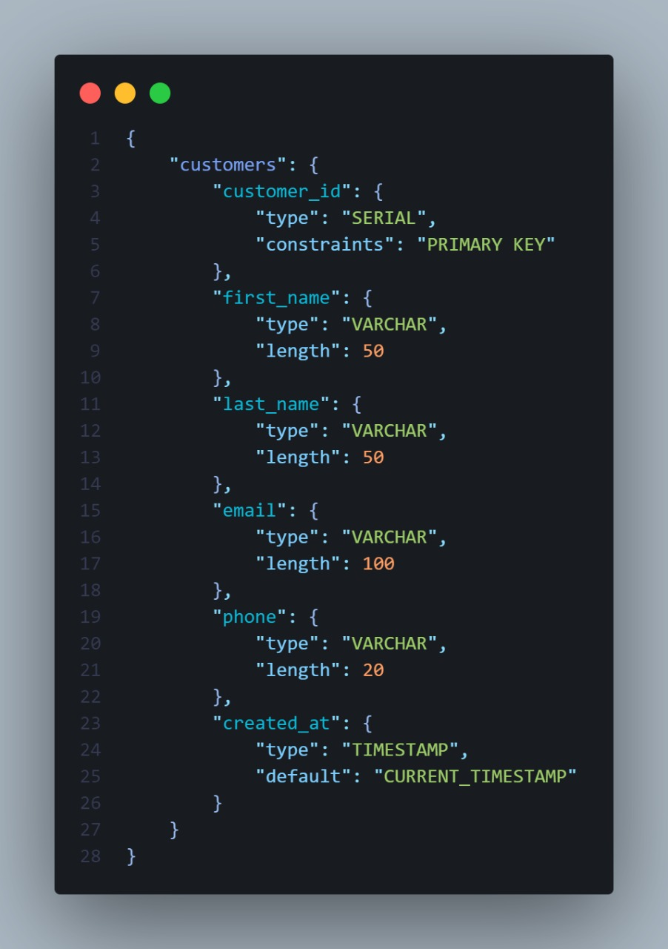
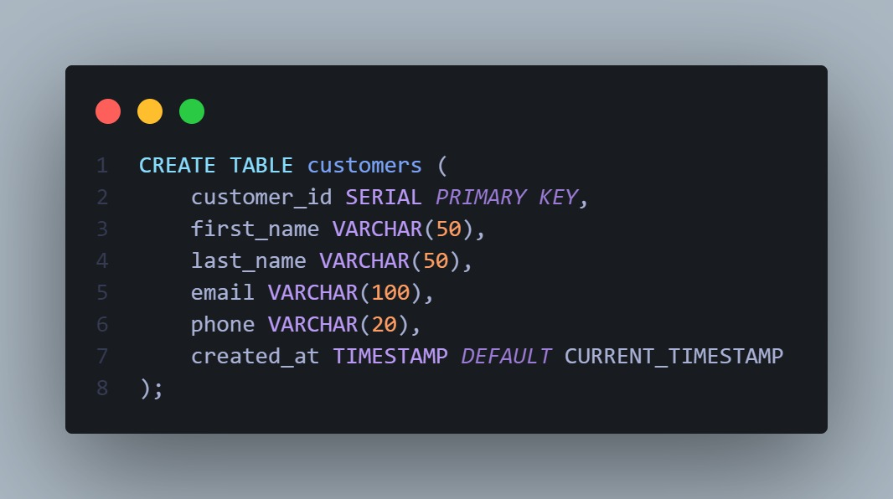
Algorithms And Techniques
01 Regex-Based SQL Parsing
8

Slide 12
Algorithms And Techniques
01 Regex-Based SQL Parsing
Extraction of DDL Statements: Uses regex to identify CREATE TABLE statements in SQL files..
Column and Constraint Identification: Extracts the inner contents of the table definition (i.e., the column definitions and table-level constraints).
Constraint Extraction: For each column definition, it looks for keywords like PRIMARY KEY and FOREIGN KEY.
9

Slide 13

Algorithms And Techniques
01 Regex-Based SQL Parsing
Simplicity & Efficiency: Regular expressions offer a lightweight method to parse text-based SQL.
Rapid Integration: Transform SQL definitions into a structured JSON-like schema without relying on external parsing libraries.
10

Slide 14
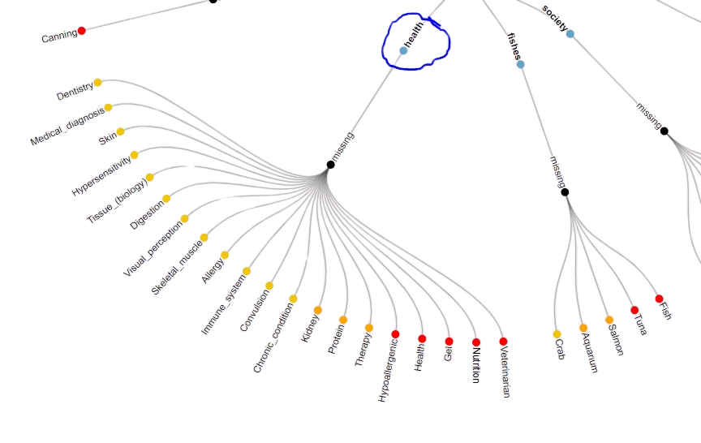
Algorithms And Techniques
02 Keyword-Based Domain Detection
11

Slide 15
Algorithms And Techniques
02 Keyword-Based Domain Detection
Keyword Dictionary: A predefined dictionary lists domains (like E-commerce, Healthcare, etc.) along with relevant keywords for each domain.
Name Extraction: Converting all names to lowercase for uniform matching.
Scoring Mechanism: For each domain, it counts the occurrences of its keywords in the list of names.
Tie Resolution: Resolves ties via first match or heuristic rules.
12

Slide 16
Algorithms And Techniques
02 Keyword-Based Domain Detection
Interpretable & Tunable: Easy to adjust by modifying keyword lists or weights, ensuring transparent domain decisions.
Effective for Clear-Cut Domains: Works well when naming conventions are clear and industry-standard.
13

Slide 17
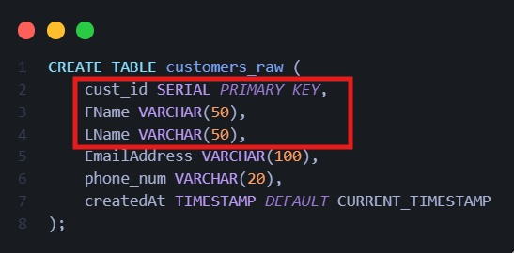
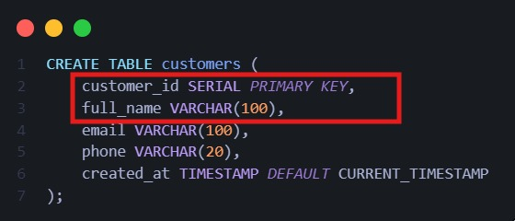
Algorithms And Techniques
03 Schema Standardization & Column Name Mapping
14

Slide 18
Algorithms And Techniques
03 Schema Standardization & Column Name Mapping
Normalization of Column Names: Maps column name variations (e.g., cust_id) to standard names (e.g., customer_id).
Iterative Standardization: Converts names to lowercase and applies mapping dictionaries.
Column Merging: Merges related columns (like first_name, last_name) into unified ones (like full_name).
Audit Columns Addition: Adds standard audit fields (created_at, updated_at) if missing.
15

Slide 19
Algorithms And Techniques
03 Schema Standardization & Column Name Mapping
Consistency Across Schemas: Reduces naming discrepancies, simplifying schema comparison and integration.
Enhanced Data Quality: Merging and audit columns ensure uniformity, aiding ETL and reporting.
16

Slide 20
Algorithms And Techniques
04 Fact and Dimension Table Identification
17

Slide 21
Algorithms And Techniques
04 Fact and Dimension Table Identification
Foreign Key Analysis: Inspects foreign keys to infer table roles.
Heuristic-Based Classification: Classifies tables referencing multiple others as fact tables; others as dimensions.
Schema Segmentation: Separates schema into fact and dimension tables for further processing.
18

Slide 22
Algorithms And Techniques
04 Fact and Dimension Table Identification
Alignment with Data Warehousing Practices: Follows standard warehousing models distinguishing facts and dimensions.
Simplified Downstream Processing: Enables table-specific enhancements and validations.
19

Slide 23
Algorithms And Techniques
05 Missing Table/Column Detection
Comparison Against a Standard Schema: Compares schema to a domain’s predefined standard schema.
Set Operations for Discrepancy Detection: Uses set differences to identify missing tables and columns.
Mapping for Table Variations: Aligns user table names to standard schema to account for name variations. (e.g., mapping customers to customer_dimension), ensuring that minor naming differences don’t falsely trigger a “missing” flag.
20

Slide 24
Algorithms And Techniques
05 Missing Table/Column Detection
Direct Gap Analysis: Efficiently highlights discrepancies essential for schema integrity.
Actionable Insights: Clearly identifies missing elements, guiding schema correction.
21

Slide 25
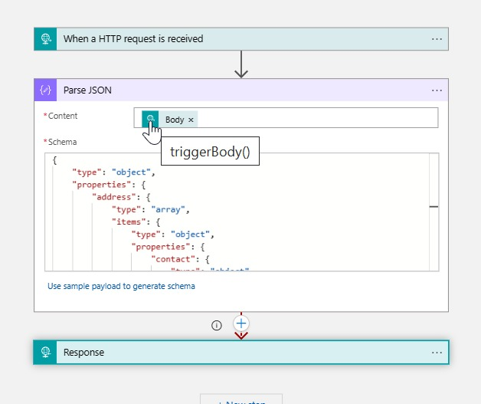
Algorithms And Techniques
06 NLP Techniques
22

Slide 26
Algorithms And Techniques
06 NLP Techniques
Advanced Tokenization and Matching: Tokenizes table/column names and applies regex or fuzzy matching.
Contextual Weighting and Semantic Validation: Assigns weighted keywords and validates scores against thresholds.
Output Structuring and Validation: Structures output with domain scores for transparent validation.
23

Slide 27
Algorithms And Techniques
06 NLP Techniques
Improved Accuracy: Reduces false negatives via enhanced tokenization and fuzzy matching.
Output Validation: Provides transparent, threshold-based validation and flags uncertain cases.
Scalable Foundation: Supports future integration of more advanced NLP models for deeper analysis.
24

Slide 28
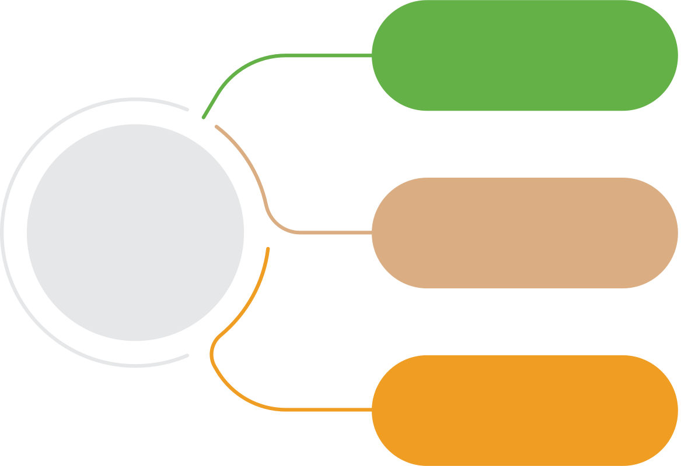
In-progress Functions
AI-Driven Prompt
Data
Forge
User Customization
User Activity Tracking
25

Slide 29
Algorithms And Techniques
In-progress
01 AI-Driven Prompt
Uses previous user prompts and stored schemas to generate relevant AI-driven prompts.
Can auto-generate a prompt based on patterns detected in historical schemas.
Supports real-time edits, where the AI refines the prompt based on user feedback.
26

Slide 30
Algorithms And Techniques
In-progress
02 User Customization
Allows users to modify the generated schema before finalizing.
Supports interactive editing, ensuring flexibility in schema design.
Applies standardization rules while allowing custom exceptions where necessary.
27

Slide 31
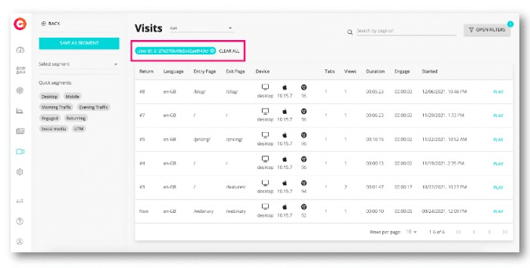
Algorithms And Techniques
Algorithms And Techniques
In-progress
03 User Activity Tracking
Maintains a history of all schemas processed by the user.
Allows users to retrieve, compare, and modify previous schemas.
Supports version tracking, ensuring users can roll back to an earlier schema.
28

Slide 32

Demo
29

Slide 33
Thank You

